Slide 1
Case study: (Sales) To analysis the relationship between Sales and Unit Price and Product and Quantity.
INTRODUCTION
In this case study , we shall be looking at the data analysis of the dataset “Sales”. Here, we take a look at:
- Dataset
- Cleaning process of the data using Spreadsheet and SQL
- Visualization with Tableaus
- Rstudio Visualization( using ggplot_point and ggplot_bar)
- Summary of the analysis
- Recommendation

Slide 2
SCENARIO
The executives wanted to know how the automobile products are doing in the American market and my team of analyst were summoned to conduct a thorough analysis on the Sales. The task given to us is to investigate the relationship between Sales and Unit Price and Product and Quantity.

Slide 3
About the company
Ottman’s automobile company is an automobile company based in New York city and was established in 1978. It has grown to be one of the elite automobile companies in the whole of United State of America.

Slide 4
Working on Spreadsheet
Using Sales.csv dataset to analysis and identify trends, I have to ensure the dataset is consistence, error-free, well-formatted, well-structured and well-organized
Checking for data completeness. Ensuring that all required columns have values in every rows , and there are no missing or blank cells.
Verifying data consistency: Looking for any inconsistencies or discrepancies within the dataset, such as conflicting or duplicating entries.
Validating the data types: Making sure that the data type is in the correct format for each column. For example, numeric columns should contain only numbers and dates columns should have consistent date format
Examine data range and outliers: Checking for any extreme or unexpected values that might indicates errors or outliers in the dataset.
Cross-reference data: comparing data across different columns or tables to ensure accuracy and consistency
Creating a Pivot Table to summarize the data for better understanding

Slide 5
Working on SQL
By Importing the data into my BigQuery Sandbox account, I took the following steps to check the dataset, perform queries and checks to validate the data
1.SELECT statement. Using the SELECT statement to retrieve specific columns or rows of data and verify if they meet certain criteria for analysis.
2. COUNT function: COUNT the number of records in a table to ensure it matches the expected count.
3. DISTINCT keyword: Using the DISTINCT keyword to identify unique values in a column and check for any unexpected duplicates.
By combining the Cleaning process in both Spreadsheet and SQL together, this ensures that the dataset is thoroughly checked and validated

Slide 6
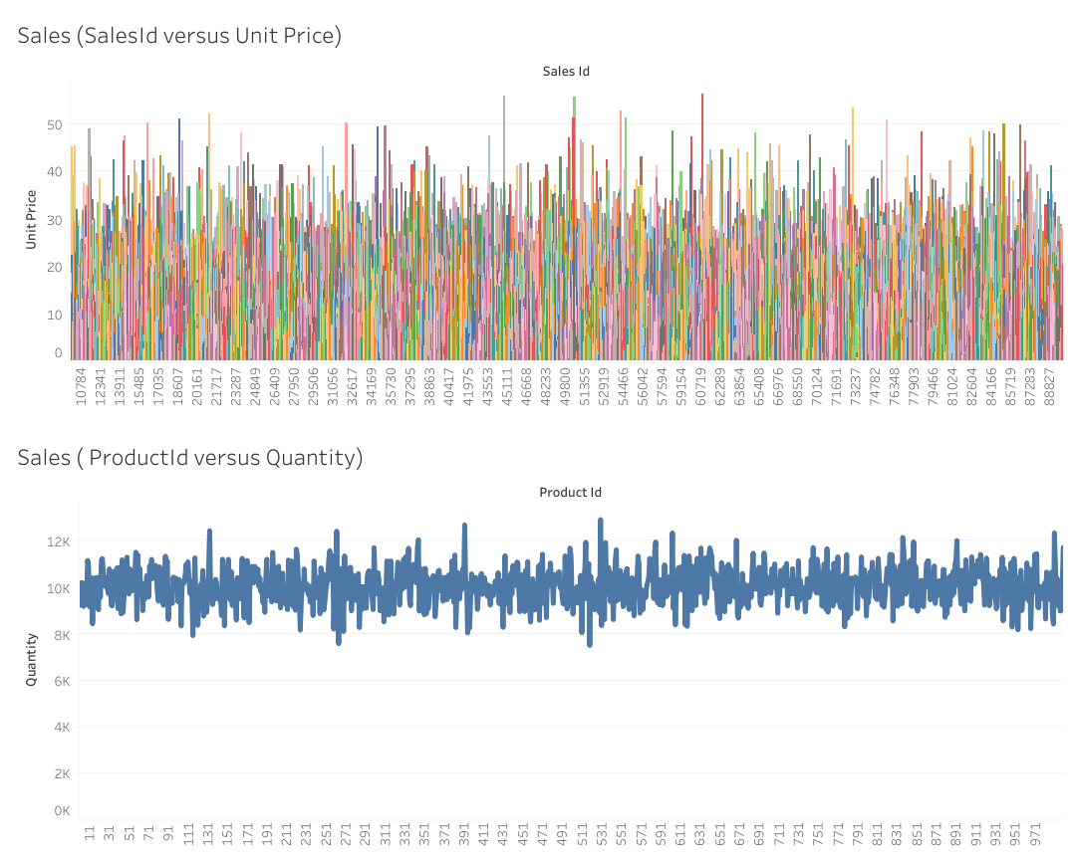
Working on Tableau. Dashboard(showcasing the two visualization)

Slide 7
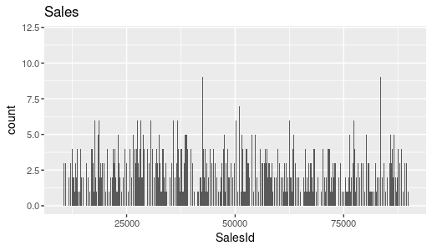
Working on Rstudio, Using ggplot to create a bar chart representing SalesId

Slide 8
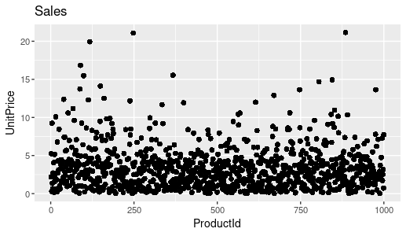
Working on RStudion using ggplot to creating a scatter plot of UnitPrice and ProductId.

Slide 9
Summary
From the visualization created on Tableau platform. It can interpreted from the trend that sales and unit price are closely related in performance, and further analysis shows their performances in the market and from customers feedbacks and market demands,
This could be said of the Product and the Quantity as shown on Tableau.
With the R, the cluster plot shows relative close relationship between the Unit Price and Product.

Slide 10
Recommendations.
From my of data analysis and the visualizations from the data presented to me, i can say that the relationship between Sales and Unit Price and Product and Quantity are relatively close and I strictly recommend that the company(Ottmans’ automobile) should not relent in their effort and continue with their production formula.

